Slide 1
Prioritization Workgroup Summary

Slide 2
Workgroup Topics
Nutrient results
What is a watershed?
What is a TMDL?
Prioritization methods
Basin framework and management

Slide 3
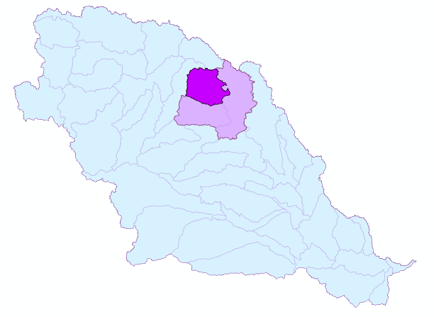
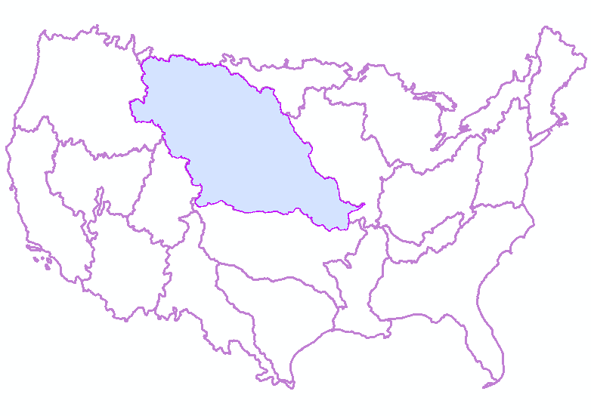
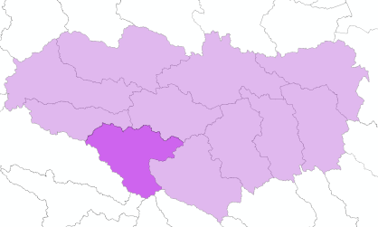
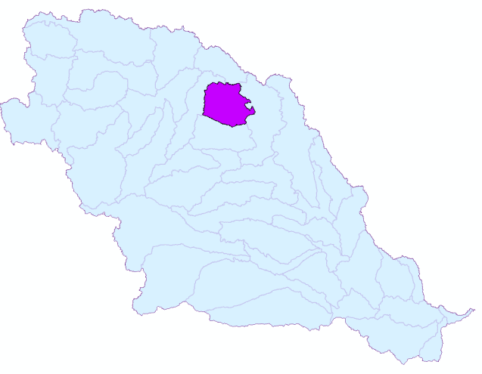
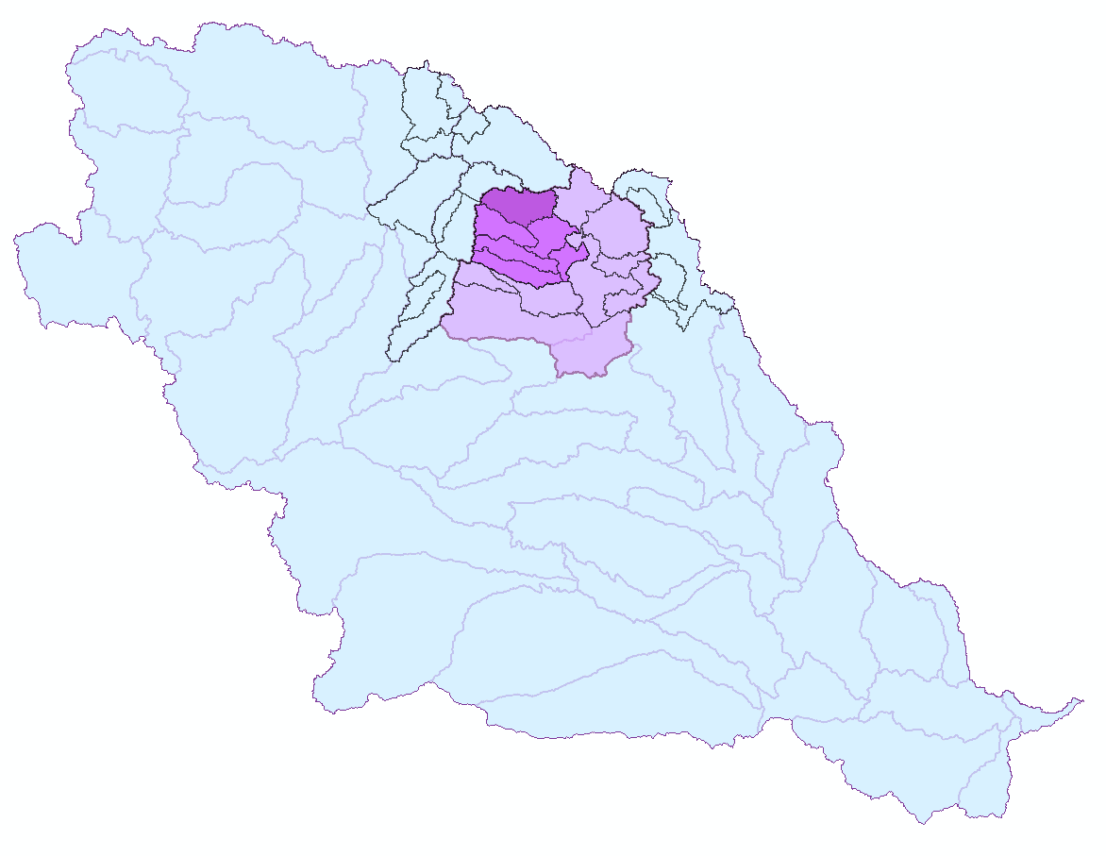
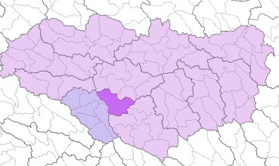
Hydrologic Unit Hierarchy
Missouri River Region 10
2
Missouri-Oahe Subregion 1013
SUBREGION
221 Nationally
HU Code: 4 digit
1
REGION
21 Nationally
HU Code: 2 digit
5
Deep Creek
1013020103
WATERSHED
5-15 per Subbasin
HU Code: 10 digit
size: 40,000-250,000 acres
3
4
BASIN
378 Nationally
HU Code: 6 digit
SUBBASIN
2236 Nationally
HU Code: 8 digit
average size: 700 mi²
Cannonball-Knife-Heart
Basin 101302
Knife River
Subbasin 10130201
SUBWATERSHED
5-15 per Watershed
HU Code: 12 digit
size: 10,000-40,000 acres (not less than 3,000)
6
Lower Deep Creek
101302010307

Slide 4
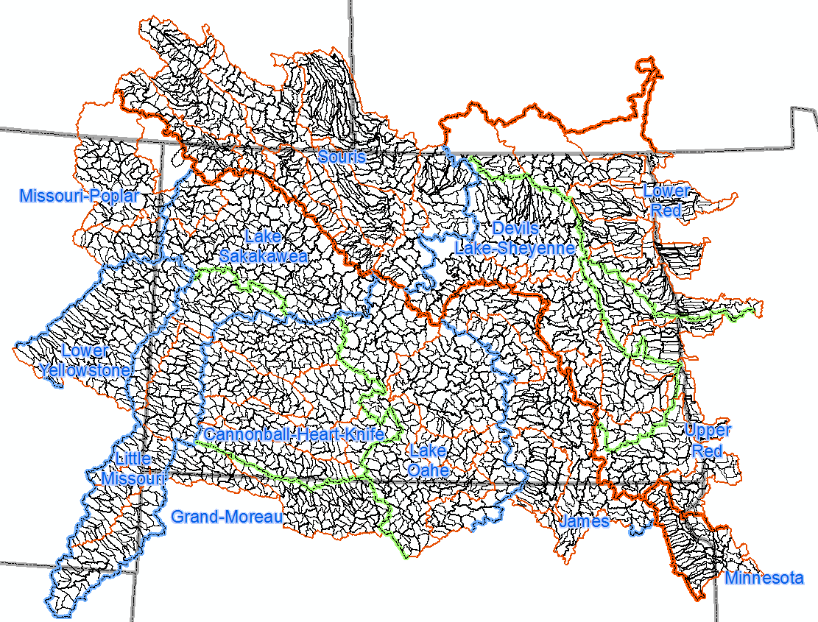

Slide 5

Parts of a TMDL
Reductions
  The is the bare bones of the TMDL itself. Creates the target to shoot for.
  TMDL(loading capacity) = WLA + LA + MOS
Table 12. Summary of the Total Phosphorus TMDL for Homme Dam (40% reduction needed)
Category | Total Phosphorus (kg/yr) | Explanation
Existing Load | 16,660 | From observed data
Loading Capacity | 9,996 | Total TP load from Monte Carlo modeling corresponding to 2010/2011 mean chlorophyll-a concentration of 16.9 µg/L
Wasteload Allocation | 0 | No point sources
Load Allocation | 8,996.4 | Entire loading capacity minus MOS is allocated to non-point sources
MOS | 999.6 | 10% of the loading capacity (kg/yr) is reserved as an explicit margin of safety
Notes:
WLA is for point sources, LA is for nonpoint sources.

Slide 6
Prioritization Methods
Decision tree method
Score card method
EPA’s Recovery Potential Screening Tool

Slide 7
Recovery Potential Screening - Basic Concept
Ecological metrics
Indicator 1
Indicator 2
Indicator 3
Indicator 4
Indicator 5….
Stressor metrics
Indicator 1
Indicator 2
Indicator 3
Indicator 4
Indicator 5….
Social context metrics
Indicator 1
Indicator 2
Indicator 3
Indicator 4
Indicator 5….
Ecological Index Stressor Index Social Index
Ecological + Social + (100 – Stressor)
3

Slide 8
Basin Management Framework
New approach to how the NDDoH organizes its water quality monitoring, assessment and management programs and projects
Five basins
  Red River
  Souris River
  James River
  Upper Missouri River (Lake Sakakawea)
  Lower Missouri River (Lake Oahe)

Slide 9
Nutrient Reduction/Basin Management Framework
Criteria
Development
Monitoring
Criteria
Development
Adaptive
Management
Implementation
Point Source
Nonpoint Source
Prioritization
Assessment
Criteria
Development
Criteria
Development
TMDL
Development

Slide 10
Summary
Pursue Recovery Potential Screening Tool as the main prioritization method for nutrient reduction and water quality management
Implement a basin management framework
  Start in the Red River basin
    Ready to go

Slide 11
Nutrient Criteria Workgroup Summary

Slide 12
Workgroup Topics
Nutrient results
State water quality standards
What are nutrient criteria?
North Dakota Nutrient Criteria Development Plan

Slide 13
Standards of Quality for Waters of the State
Authority provided in NDCC 61-28
Required as part of the Clean Water Act
Implemented as state regulations
  NDAC 33-16-02.1
Defines “waters of the state”
Defines beneficial uses for “waters of the state”
Describes narrative and numeric standards to protect waters of the state
Describes “antidegradation” policies and procedures to protect “waters of the state”

Slide 14
What are Nutrient Criteria?
Nitrogen
Phosphorus
Algal biomass (e.g., chl-a)
Water clarity (e.g., secchi)
Photo credit: Carl Heilman
www.carlheilman.com
Notes:
What are nutrient criteria?
Numeric water quality criteria for N, P, some measure of algal biomass such as chlorophyll-a and some measure of water clarity such as secchi depth in lakes or turbidity in streams.
EPA’s expectation is that all states will ultimately adopt nutrient criteria for all waters including lakes, rivers/streams, estuaries, coastal waters and wetlands.
A number of states have narrative criteria for nutrients, but narrative criteria have largely been ineffective..

Slide 15
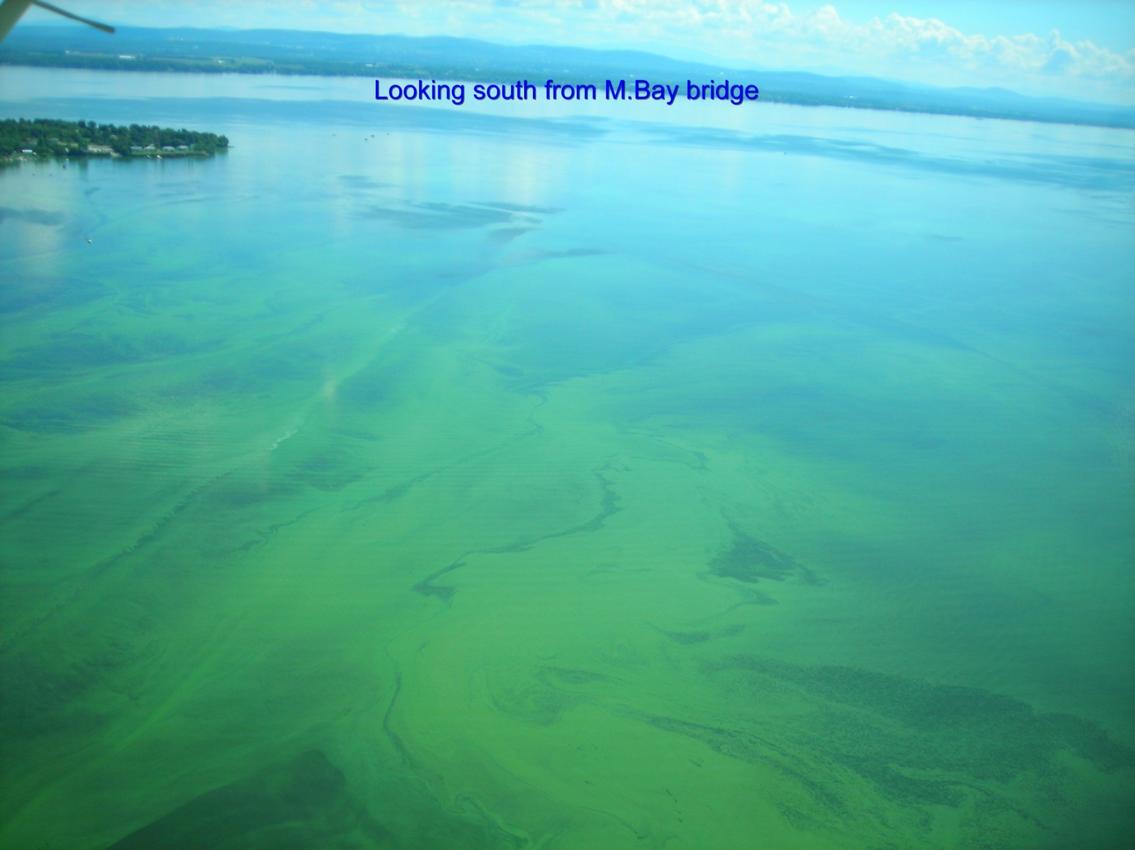
Why are nutrient criteria needed?
Determine when waters are impaired;
Identify restoration targets for impaired waters;
Set permit limits for point sources and better inform nonpoint source efforts to protect waters before they become impaired.
Notes:
Why are nutrient criteria needed?

Slide 16
Nutrient Criteria Development Plan for
North Dakota

Slide 17
EPA’s National Strategy Approach
Phase II
  States given the flexibility to select and implement an approach for nutrient criteria which will be adopted as standards
    Adopt EPA nutrient criteria based on aggregate Level III ecoregions (as a range of values or a single value with the range)
    Combine EPA recommendations for nutrient criteria with their own databases to develop their own statistically-based criteria
    Use EPA methodology (or some other accepted approach) for defining criteria or, alternately, construct a scientifically defensible method for developing nutrient water quality criteria

Slide 18
North Dakota’s Nutrient Criteria Development Plan
Described in detail in the State of North Dakota Nutrient Criteria Development Plan (May 2007)
Goal
  To develop technically defensible nutrient criteria for surface waters, which are protective of the resource, and consistent with federal guidance

Slide 19
North Dakota Approach
Guiding Principles
  Protective of the state’s water resources and their designated uses
  Tailored to the unique physiographic characteristics and water resources of this region (i.e., northern plains)
  Technically and scientifically defensible
  Based upon conceptual ecosystem models that reflect cause (stressor) – effect (response) relationships founded on excess nutrient concentrations and that reflect the reasons for resource impairment (e.g., excessive algae in a lake) and the loss of beneficial uses

Slide 20
Workgroup Summary
Current Nutrient Criteria Development Plan makes sense
  No reason to change
Identify priority waterbodies to begin nutrient criteria development
  Lake Sakakawea
  Red River
  Others????

