Slide 1
North Dakota Nutrient Reduction Strategy
Prepared for the Point Source Workgroup
October 14, 2014
Fargo, ND

Slide 2
Where have we been?
Nutrient criteria development plan – May 2007
Initial discussions on a state strategy in late 2011
Based, in part, on Stoner memo (March 16, 2011)
Formed planning team
Selected facilitator
EPA contractor assistance
Developed Fact Sheet
1st Planning Team meeting Nov. 20, 2012
Stakeholder meeting December 19, 2013

Slide 3
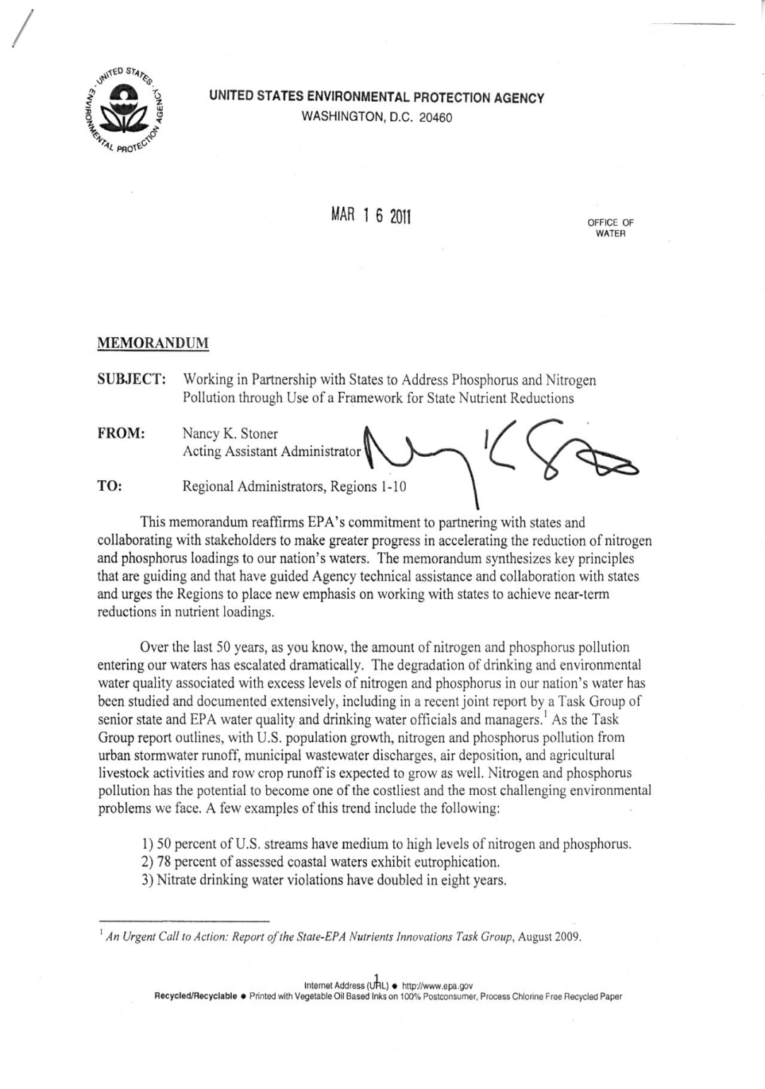
Nutrient Reduction Framework Memo
Notes:
Realizing the urgency of this issue, In March 2011, EPA’s Office of Water issued a memo entitled “Working in Partnership with States to Address Phosphorus and Nitrogen Pollution Through Use of a Framework for State Nutrient Reductions.”
The memo emphasized that N and P pollution has the potential to become one of the costliest and most challenging environmental problems that we face and reaffirmed the agencies commitment to partner with states and collaborate with stakeholders to make greater progress in accelerating the reduction of N and P loadings to our nation’s waters.

Slide 4
Nutrient Framework:
Recommended Elements
Prioritize watersheds and set load reduction goals
Ensure effectiveness of source reduction strategies: point source permits, storm water and septic systems, agricultural areas
Ensure accountability and report progress to public
Continue with numeric nutrient criteria development

Slide 5
Where have we been?
Nutrient criteria development plan – May 2007
Initial discussions in late 2011
Based on Stoner memo
Formed a planning team
Selected facilitator
EPA contractor assistance
Developed Fact Sheet
1st Planning Team meeting Nov. 20, 2012
Stakeholder meeting December 19, 2013

Slide 6
Planning Team
Sector | Agency/Organization
Agriculture Sector | ND Stockman’s Association
 | ND Assoc. of Soil Conservation Districts
 | ND Farmers Union
 | ND Farm Bureau
Municipalities/Local Government | Public Utilities, City of Bismarck
 | ND League of Cities
 | ND Association of Counties
 | ND Tribes, Standing Rock Sioux Tribe
Industry | Tesoro Refinery/ND Water Pollution Board
 | American Crystal Sugar
 | ND Lignite Energy Council
 | ND Petroleum Council

Slide 7
Planning Team
Sector | Agency/Organization
Regulatory/Agency | ND Dept of Agriculture
 | ND State Water Commission
 | ND Game and Fish Dept
 | US Fish and Wildlife Service
Environmental | ND Wildlife Federation
 | Dakota Resource Council
 | Sierra Club-Dakotah Chapter
Exofficio Members | USGS
 | NRCS
 | US EPA Region 8
 | NDSU Extension

Slide 8
Where have we been?
Nutrient criteria development plan – May 2007
Initial discussions in late 2011
Based on Stoner memo
Formed planning team
EPA HQ contractor assistance (i.e., Tetra Tech)
Developed Fact Sheet
Held first Planning Team meeting on Nov. 20, 2012

Slide 9
1st Planning Team Meeting
Purpose -
  Meet and get to know one another.
  Come to a common understanding of the nutrient management issues facing our state and to identify gaps in our common understanding.
  Begin to outline the key elements of a state strategy and the process for developing the strategy.

Slide 10
2nd Planning Team Meeting
April 11, 2013
Purpose –
  Receive an update on other states’ progress towards nutrient management strategies.
  Approve the draft outline of North Dakota’s Statewide Nutrient Reduction Strategy
  Review processes and procedures for prioritizing watersheds/waterbodies for nutrient reduction.
  Develop technical work groups to forward the development of the statewide strategy.

Slide 11
Nutrient Reduction Strategy Outline
1. Backgound
Scope of the problem
What are nutrients and why are they a problem
Nationally and internationally
State and local
Sources and stressors
2. Why a nutrient reduction strategy for ND
History with the issue
EPA
Nutrient strategy development process
Other nutrient reduction efforts?
MT
MN
Red River basin
Current and past efforts to address nutrient management
Lessons learned
Practices that worked and didn’t work

Slide 12
Nutrient Reduction Strategy Outline
3. How does a nutrient management strategy relate to other watershed and water quality management programs and activities in the state?
Section 319 NPS Management Program
Water Quality Monitoring and Assessment
Wetland Protection
TMDL Program
Regulatory programs (e.g., NDPDES, Stormwater, septic systems, AFO/CAFO)
Water Quality Standards
Basin planning
SWC
NRCS locally lead process
Municipal and county planning and zoning

Slide 13
Nutrient Reduction Strategy Outline
4. Elements of a state nutrient reduction strategy
Priority watersheds
Prioritization factors
Load and targets
Nutrient criteria and TMDLs
Source reduction strategies
NPS (Agriculture, Urban)
Point sources
Industrial, Municipal
Stormwater, Septic systems, AFO/CAFO
Monitoring

Slide 14
Nutrient Reduction Strategy Outline
4. Elements of a state nutrient reduction strategy (con’t)
Nutrient criteria
Nutrient criteria development plan
Narrative
Targets/criteria developed and expressed through site specific TMDLs or
other studies/investigations
Accountability and verification measures
Monitoring and assessment
Adaptive management
Reporting

Slide 15
2nd Planning Team Meeting
April 11, 2013
Purpose –
  Receive an update on other states’ progress towards nutrient management strategies.
  Approve the draft outline of North Dakota’s Statewide Nutrient Reduction Strategy
  Review processes and procedures for prioritizing watersheds/waterbodies for nutrient reduction.
  Develop technical work groups to forward the development of the statewide strategy.

Slide 16
Workgroups
Planning Team
Coordination, Communication, Reporting
Prioritization, Loads & Targets
Sector Work Groups
Public
General nutrient issues
Stakeholders
Statewide stategy
Outreach Work Groups
Ag/NPS
Municipal/ Industrial Point Sources
Technical Work Groups
Criteria
Livestock
Septic Systems
Row Crops
WWTPs
MS4s
Industrial
Urban

Slide 17
December 19th Stakeholder Meeting
  Purpose –
    Inform stakeholders of efforts to date
    Seek input from a broad group of stakeholders with an interest and stake in the nutrient problem and reduction strategies in the state
      91 participants
    Convene workgroups and begin the process of developing the elements of the strategy

Slide 18
December 19th Stakeholder Meeting
  Workgroup results
    Five workgroups
      Point sources
      Ag/nonpoint sources
      Prioritization
      Nutrient Criteria
      Education/Outreach
    Carousel Process
      Why?
      How?
      Elements and Considerations
      Roadblocks

Slide 19
December 19th Stakeholder Meeting
  Point sources
    Why?
      Keep control at local level (keep EPA out) (13)
      Prevention is easier than correction (13)
      Protect drinking water (11)
      Watershed prioritization (9)
    How?
      Source control (reduced phosphorus content on products, appropriate application, public education) (22)
      Funding programs (17)
      Improved erosion and sediment control (9)
      Nutrient recycling for “beneficial” uses (7)

Slide 20
December 19th Stakeholder Meeting
  Point sources
    Elements and considerations
      Funding and costs (cost/benefit, bang for the buck, most beneficial) (23)
      Implementation and prioritization (municipal, industrial, watersheds, etc.) 8
      Waste that is generated from treatment (7)
      Is it reasonable? What is reasonable? Who defines reasonable? (7)
    Roadblocks
      $$$$ (22)
      Value-measurable benefits (15)
      Amount of available data to justify numeric limits (11)
      Fairness across stakeholders (fairness across jurisdictions) (11)

Slide 21
Workgroup Outcomes
Prioritization
  Evaluated a number of prioritization methods
  Recommended the Recovery Potential Screen Tool process which has been developed by EPA Headquarters
    Developed initially as a statewide prioritization method for the nutrient reduction strategy
    Adapted by major river basin in the state and for other prioritization scenarios (e.g., TMDL development, monitoring, Section 319 watershed implementation)

Slide 22
What is Recovery Potential Screening?
A method to help
states and restoration planners
compare restorability across watersheds
Science-based, indicator-driven (GIS and field monitoring data)
Scores and compares watersheds relative to their:
ecological condition,
exposure to stressors, and
social context affecting restoration efforts

Slide 23
How does it work?

Slide 24
Recovery Potential Screening - Basic Concept
Ecological metrics
Indicator 1
Indicator 2
Indicator 3
Indicator 4
Indicator 5….
Stressor metrics
Indicator 1
Indicator 2
Indicator 3
Indicator 4
Indicator 5….
Social context metrics
Indicator 1
Indicator 2
Indicator 3
Indicator 4
Indicator 5….
Ecological Index Stressor Index Social Index
Ecological + Social + (100 – Stressor)
3

Slide 25
Recovery Potential Screening: Example Indicator Selections
RPS Indicator selection for screening based on prioritizing pathogen TMDLs
ECO | STRESSOR | SOCIAL
Percent natural cover | Percent pasture in watershed | Jurisdictional complexity
Percent forest in corridor | Percent impervious in watershed | TMDL count
Stream density | Percent septic in stream corridor | Percent protected lands
Stream order | Percent sewered | Active volunteers
Change in natural cover | Impairments count
RPS Indicator selection for screening based on development risks to watersheds
ECO | STRESSOR | SOCIAL
Percent_NaturalCover | Percent_Sewered | Percent_Stressors_Known
Percent_Forest_In_Corridor | Percent_Impervious | Percent_Length_Assessed
Percent_Wetlands | Percent_Impervious_>5_In Corridor | Percent_Watershed_Protected_Lands
Topo_Complexity | Percent_Length_Impaired | Low_Jurisdictional_Complexity
NFHAP_HCI_Condition | Road_Density | Low_Landuse_Complexity
Combined_Natural_Habitat_Index | Percent_Septic_In_Corridor | Active_Volunteers_Count
Percent_Change_Natural_Cover | Population_In_Corridor_With_Septic | Percent_Source_Water_Protection_Area
Percent_Natl_Eco_Framework | Population | Other_Priority_Recognition
 | Stressor_Count

Slide 26
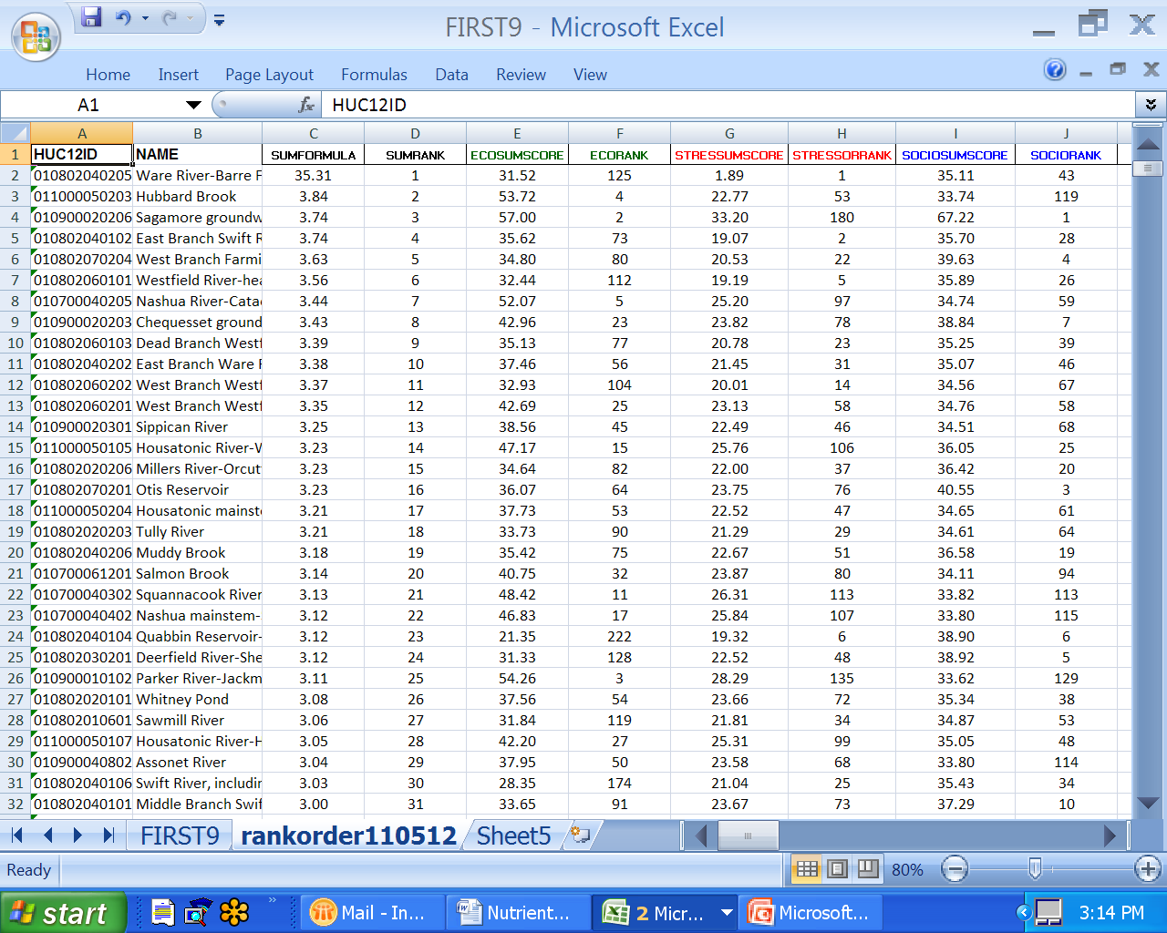
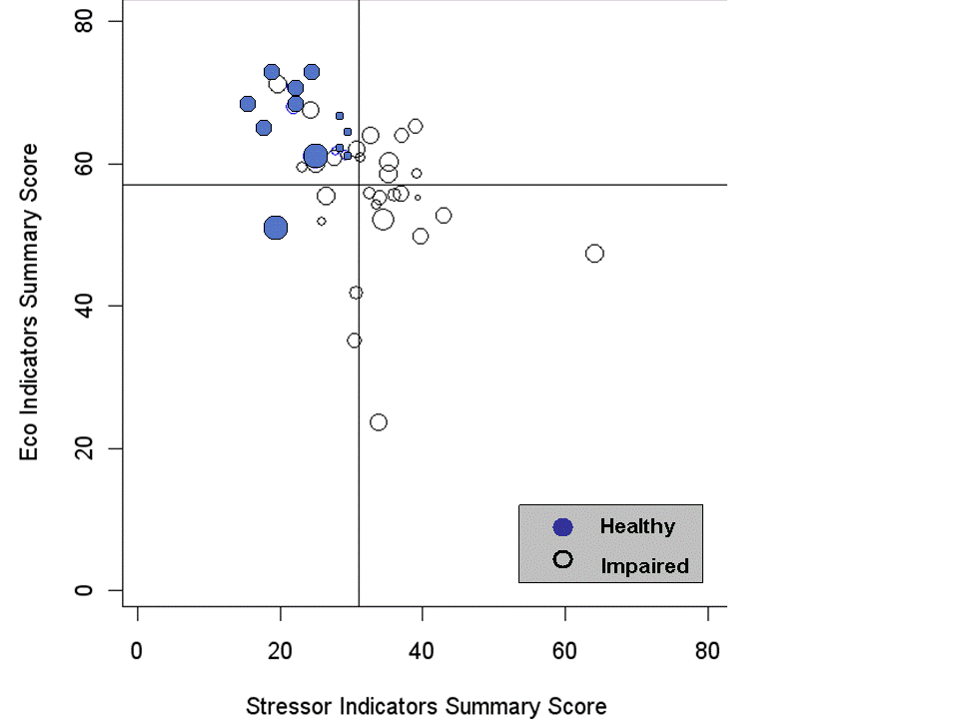
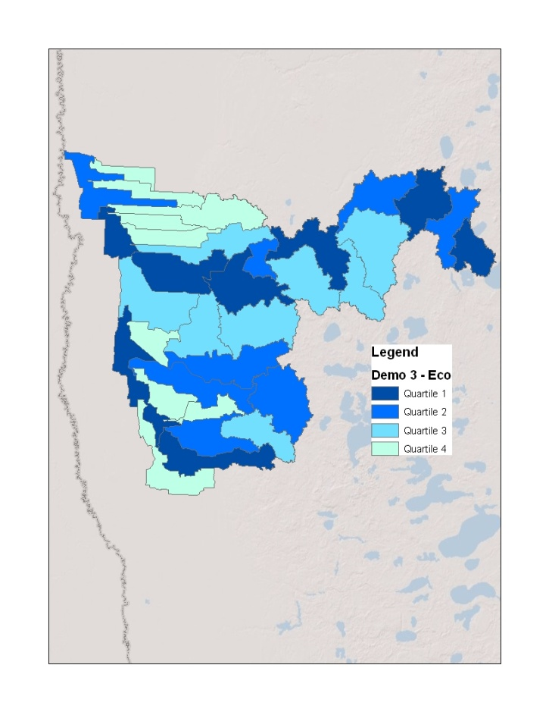
Three Types of Recovery Potential Screening Products
(from the indicator scoring)
Rank Ordering
Bubble Plotting
Mapping

Slide 27
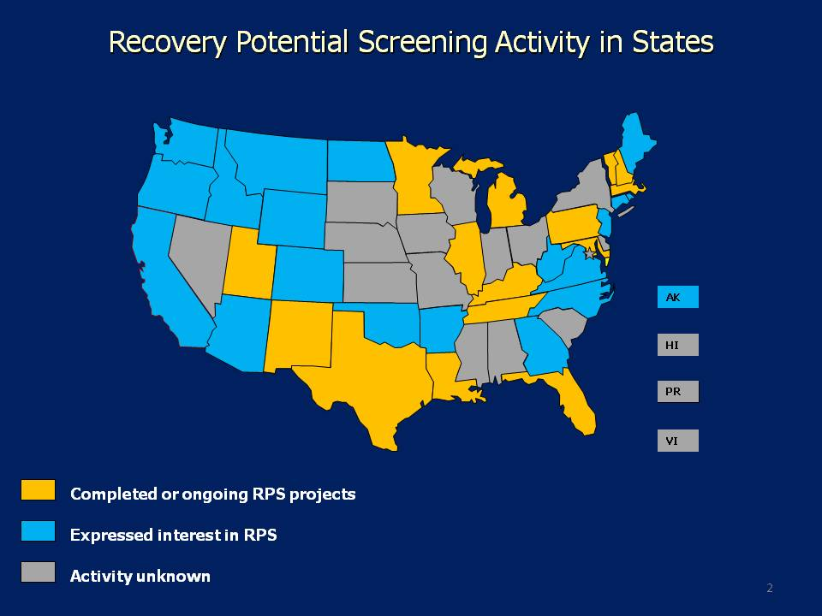
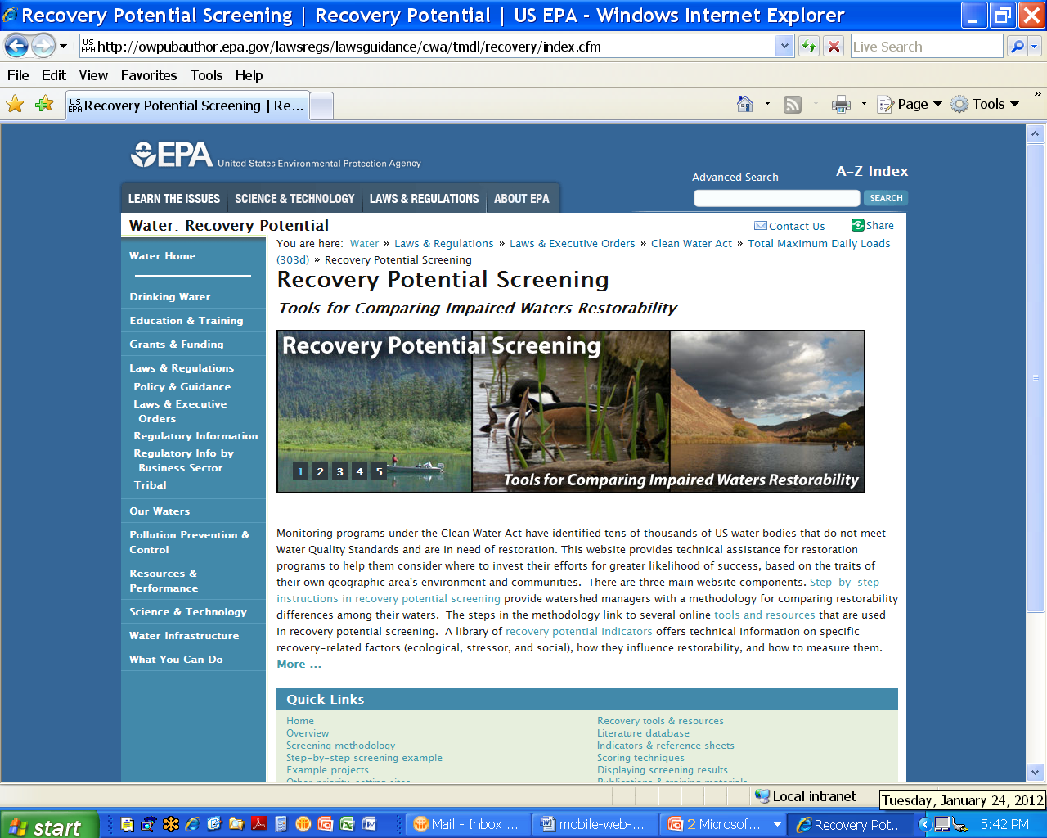
www.epa.gov/recoverypotential/

Slide 28
Workgroup Outcomes
Nutrient Criteria
  Evaluated the state nutrient criteria development plan developed in 2007
  Recommended including the 2007 plan in the strategy with minor revisions
  Workgroup will continue to meet to recommend specific priority waterbodies for nutrient criteria development
    Lake Sakakawea
    Red River

Slide 29
North Dakota’s Nutrient Criteria Development Plan
Goal
  To develop technically defensible nutrient criteria for surface waters, which are protective of the resource, and consistent with federal guidance

Slide 30
North Dakota Nutrient Criteria Development Plan
Provides the framework for criteria development
Includes lotic systems (small to large wadable and non-wadable rivers and streams)
  Recognizes Missouri River and Red River as unique river resources
Includes lentic systems (lakes and reservoirs)
  Small lakes and reservoirs vs. mid- and large lakes and reservoirs
Excludes wetlands

Slide 31
North Dakota Approach
Guiding Principles
  Protective of the state’s water resources and their designated uses
  Tailored to the unique physiographic characteristics and water resources of this region (i.e., northern plains)
  Technically and scientifically defensible
  Based upon conceptual ecosystem models that reflect cause (stressor) – effect (response) relationships founded on excess nutrient concentrations and that reflect the reasons for resource impairment (e.g., excessive algae in a lake) and the loss of beneficial uses

Slide 32
Nutrient Criteria Development Considerations
Spatial scale of criteria
  Ecoregions
  Hydrologic basins
Temporal scale
  Reflect the timing (when during the year) and duration (how long) of the effect or impairment
Stressor – Response Relationship
  Quantifiable (i.e., must be able to measure both variables)
  Criteria or standard may be an expression of one or the other or both

Slide 33
Nutrient Criteria Development Considerations
Classification
  Reservoirs and lakes (Lentic systems)
    Reservoirs
      Large river reservoirs (e.g., Lake Sakakawea, Lake Oahe, Jamestown Reservoir, Pipestem Reservoir, Lake Ashtabula, Lake Tschida, Patterson Lake, Bowman-Haley Reservoir, Lake Darling)
      Small and medium river reservoirs (e.g., Brewer Lake, Sweet Briar Dam, McDowell Dam, Fordville Dam, Odland Dam)
    Natural lakes
      Shallow lakes (e.g., Lake Hoskins, Green Lake, Powers Lake)
      Non-shallow lakes (e.g., Spiritwood Lake, Devils Lake)

Slide 34
Nutrient Criteria Development Considerations
Classification (con’t)
  Rivers and Streams (Lotic systems)
    Perennial
      Wadable
      Non-wadable (large)
      Missouri River and Red River
    Intermittent/Ephemeral

Slide 35
Defining the Stressor – Response Relationship
Conceptual Models
  Describes how a system works (conceptually)
  Describes hypothesized relationships among sources, stressors (e.g., nutrients), and biotic responses within aquatic systems
  Provides a framework for data collection and analysis
  Red River workshop

Slide 36
Workgroup Outcomes
Nutrient Criteria
  Evaluated the state nutrient criteria development plan developed in 2007
  Recommended including the 2007 plan in the strategy with minor revisions
  Workgroup will continue to meet to recommend specific priority waterbodies for nutrient criteria development
    Lake Sakakawea
    Red River

Slide 37
Workgroup Outcomes
Agriculture/Nonpoint Sources Workgroup
  Development of a conservation systems handbook for North Dakota
    Sub group made up of NDSU Extension, NDSU faculty, NRCS, commodity groups, Health Department, ND Dept of Agriculture
    Tailored to the unique regions in the state (east to west)
    Focus on agricultural BMPs applied in a systems approach that address nutrient reduction
    Recognize that there are multiple benefits from conservation systems (i.e., wildlife, soil health, flood mitigation)

Slide 38
Education and Outreach Workgroup
  Made up of 1-2 members from each of the other workgroups

Slide 39
Putting It All Together
Health Dept will be tasked with writing the strategy
Integrating the workgroup products into the elements of the strategy
Planning team will continue to review and provide input into the strategy development process
At least one more stakeholder meeting to review and comment on the strategy

Slide 40
Basin Framework for Water Quality Management

Slide 41
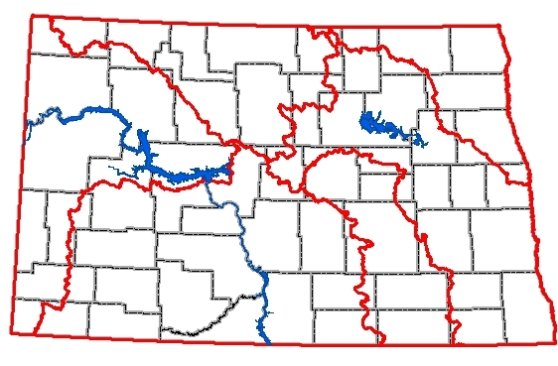
Major River Basins in ND

Slide 42
Nutrient Reduction/Basin Management Framework
Criteria
Development
Monitoring
Criteria
Development
Implementation
Point Source
Nonpoint Source
Prioritization
Assessment
Criteria
Development
Criteria
Development
TMDL
Development

Slide 43
Questions?

